Slide 1
Search and Optimization on TSP, Frozen Lake
AI Assignment 2
Team: ASHANT KUMAR (CS24M113)
IIT TIRUPATI, AI Submission Date: APRIL 06, 2025

Slide 2
Problem Setup & Heuristics
Environments:
🔷 gym_TSP: For HC & SA
❄️ FrozenLake : For BnB & IDA*
Algorithms:
Branch and Bound (BnB)
Iterative Deepening A* (IDA*)
Hill Climbing (HC)
Simulated Annealing (SA)
Heuristics Used:
FrozenLake : Manhattan Distance to goal
TSP: Total path cost from permutation of cities
Evaluation Metrics:
Reward = -1 * Distance/Steps
Time (sec)
Convergence Point (iterations)

Slide 3
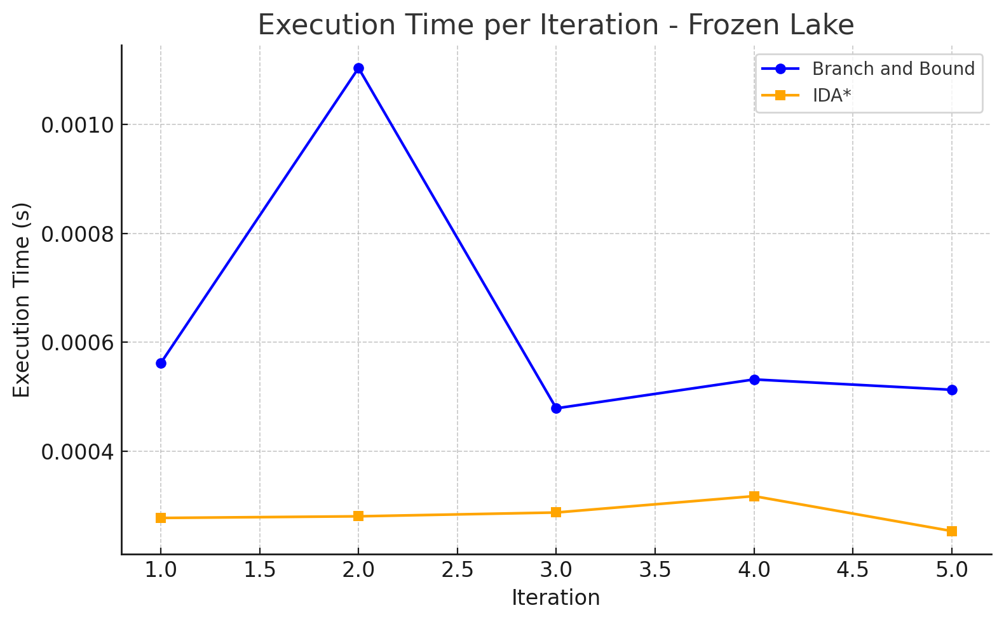
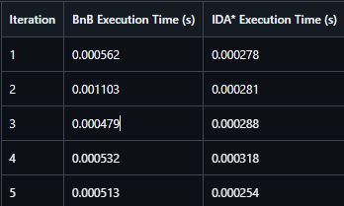
🔎 Branch and Bound vs IDA*
Environment: Frozen Lake Tested over 5 runs, with τ = 10 mins
📈 Graph: Execution time across iterations for Branch and Bound vs IDA* on Frozen Lake
🧠 Observation:
BnB is slightly higher average time due to one outlier run but memory intensive because it maintains an explicit search tree.
IDA* is faster on average and more consistent, but uses less memory due to its depth-first nature.
bnb_frozenlake.gif
ida_frozenlake.gif
Metric | Branch and Bound (Avg) | IDA* (Avg)
Time (FL) | 0.0006378 s | 0.0002838 s
Success Rate | 5/5 | 5/5

Slide 4
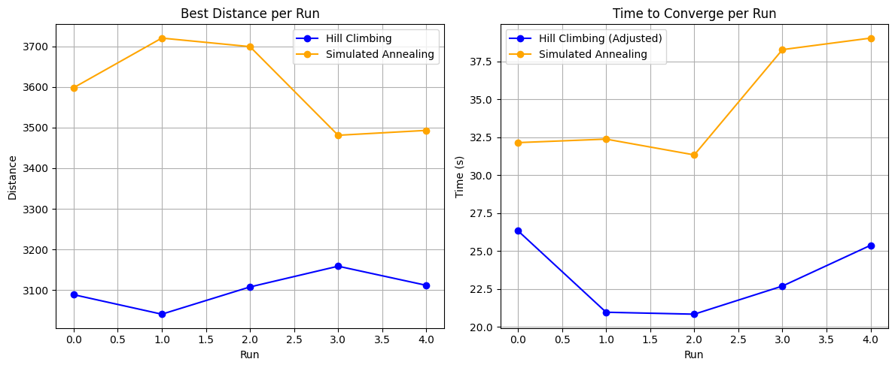
🧭 Hill Climbing vs Simulated Annealing
sa_tsp.gif
hc_tsp.gif
Environment: TSP (126 cities) Tested over 5 runs, with τ = 10 mins
📈 Graph: Avg Time to Converge
🧠 Observation:
HC is faster due to stuck on local minima it restarts which makes it slower than SA but greedy
SA is slower but more exploratory — avoids premature convergence.
Tradeoff: SA takes more time but generally finds better-quality paths.
Metric | Hill Climbing (Avg) | Simulated Annealing (Avg)
Time | 23.2s | 34.6s
Best Distance | 3101.8 | 3598.2

Slide 5
⚖️Algorithm Comparison
Algorithm | Time Taken | Converge Pt | Success Rate | Strength
BnB | Low | Fast | High | Guaranteed optimal if time
IDA* | Medium | Medium | Good | Low memory, longer path
HC | High | Early | Moderate | Fast convergence
SA | Medium | Late | High | Better global optima
🎯 Takeaway: Choice of algorithm depends on:
Problem complexity
Trade-off: time ⏱️ vs solution quality 🧠

Slide 6
Conclusion & GitHub Link
Key Learnings:
No single algorithm wins everywhere
Heuristics deeply affect performance
SA and BnB give better final results at higher cost
GitHub Repo: 🔗 https://github.com/Ashantfet/AI_Optimation_search
Thank You! 🎉

